Slide 1
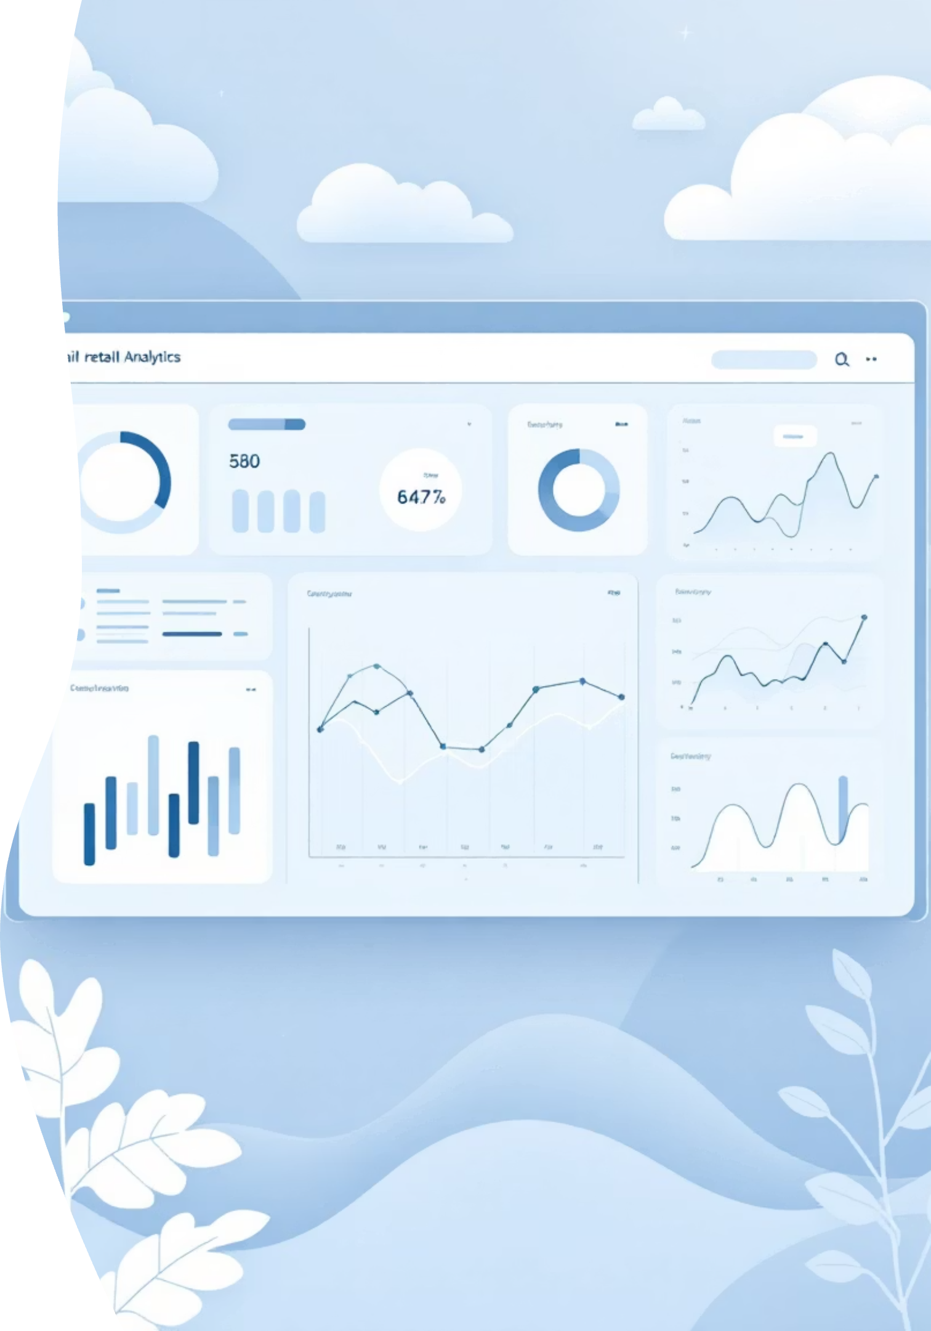
Customer Shopping Behavior Analysis
Uncovering insights from 3,900 purchases to guide strategic business decisions

Slide 2
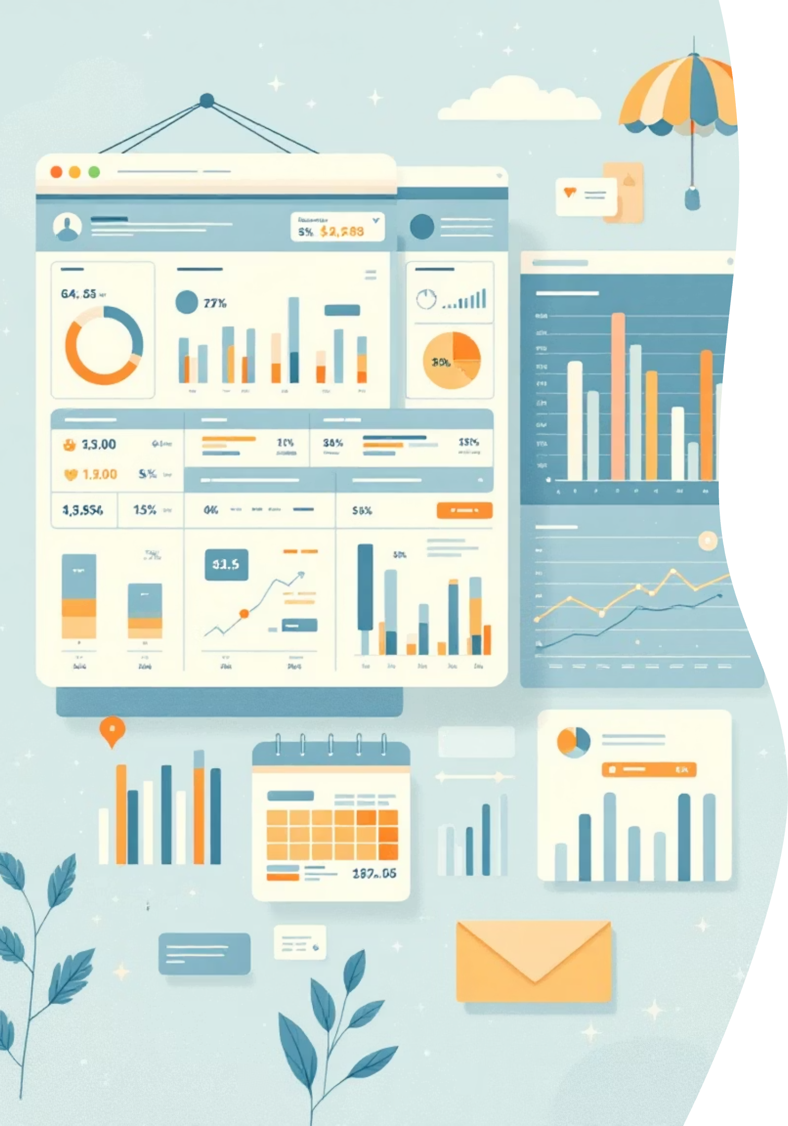
DATASET OVERVIEW
The Foundation
3.9K
18
4
Total Purchases
Data Points
Categories
Transactions analyzed across all categories
Comprehensive customer and purchase attributes
Clothing, Accessories, Footwear, Outerwear
50
Locations
Geographic diversity across customer base

Slide 3

PYTHON ANALYSIS
Data Preparation Journey
01
02
03
Data Loading & Exploration
Missing Data Handling
Feature Engineering
Imported dataset, checked structure and summary statistics
Imputed 37 missing Review Ratings using category medians
Created age groups and purchase frequency metrics
04
05
Data Consistency
Database Integration
Standardized columns, removed redundant promo code field
Loaded cleaned data into PostgreSQL for SQL analysis

Slide 4

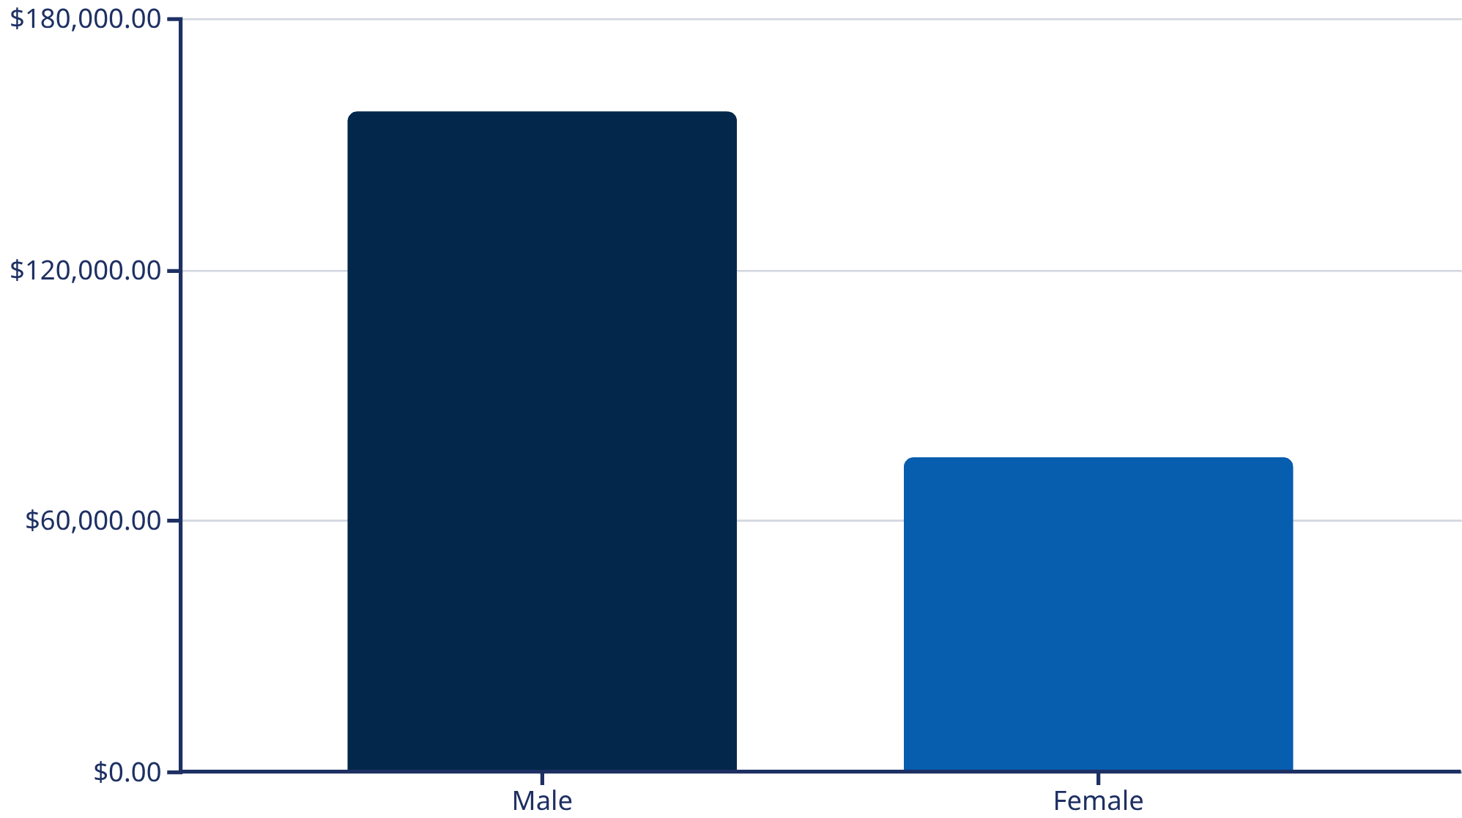
SQL INSIGHTS
Revenue by Gender
Key Finding
Male customers generate 2.1x more revenue than female customers
Total combined revenue: $233,081

Slide 5




Smart Discount Users
839 Customers
High Value
Used discounts but spent above average
Average spend: $60+ despite discounts
Strategic Segment
Price-conscious yet willing to spend
These customers represent a valuable segment: discount-driven but not low-spenders. They respond to promotions while maintaining healthy purchase amounts.

Slide 6
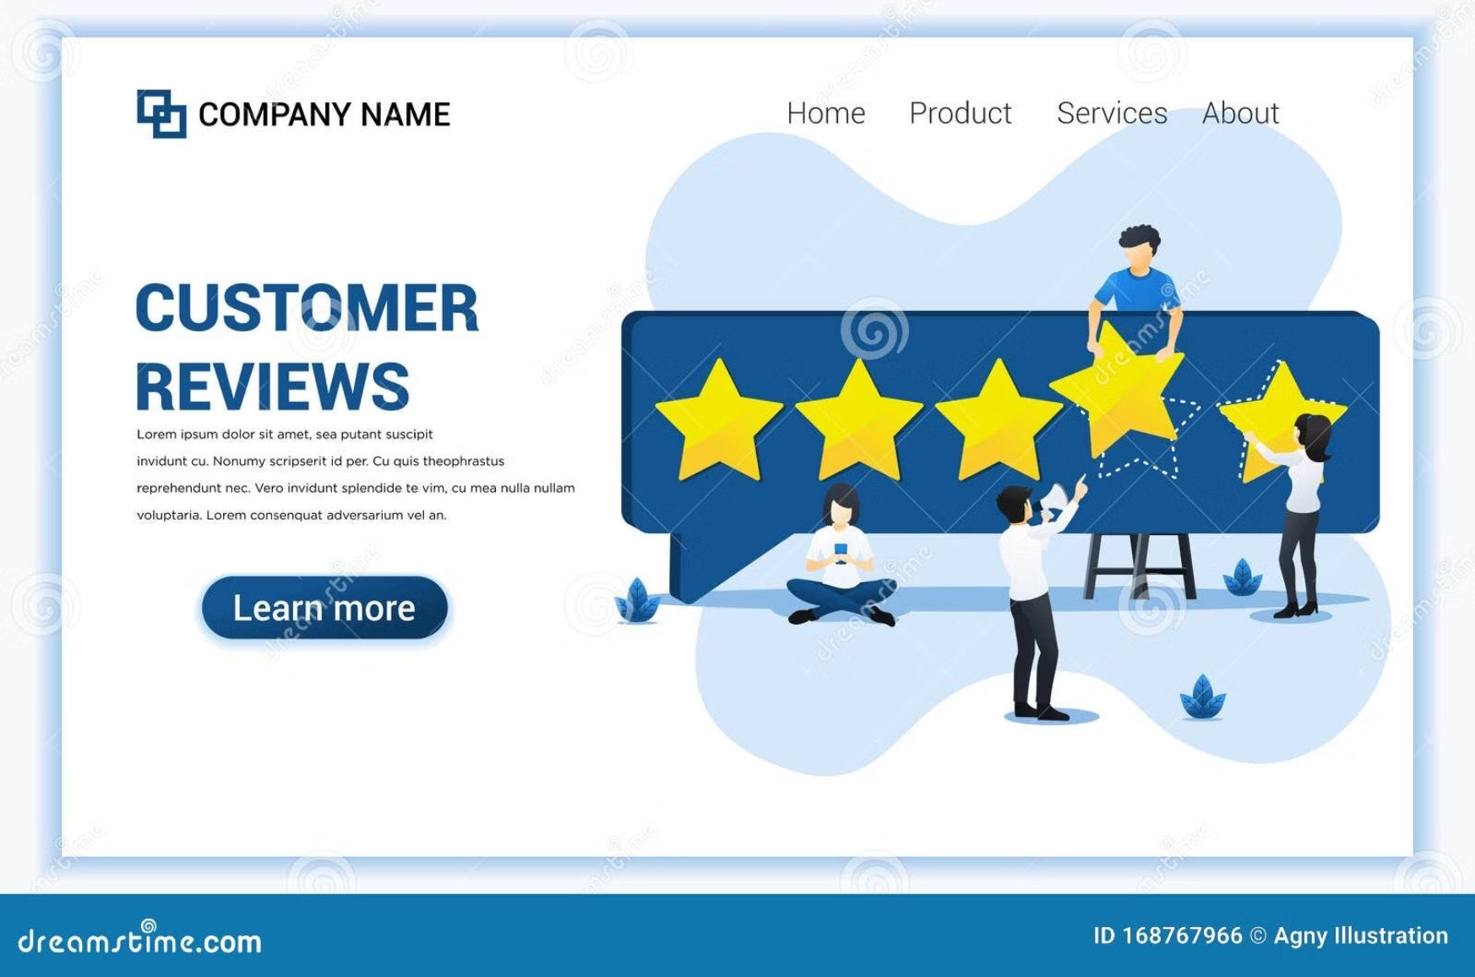
PRODUCT PERFORMANCE
Top-Rated Products
77%
Gloves (3.86)
Top Performer: Consistently high satisfaction
77%
Sandals (3.84)
Close Contender: Highly favored seasonal item
76%
Boots (3.82)
Strong Rating: Reliable and popular choice
76%
Hat (3.80)
Solid Performer: Steady customer approval
Average rating across all products: 3.75
These top performers exceed the baseline and should be featured prominently
76%
Skirt (3.78)
Well-Received: Appeals to a broad audience

Slide 7



Customer Segmentation
New
1
83 customers
Returning
2
701 customers
Loyal
3
3,116 customers
The customer base is dominated by loyal buyers (80%), indicating strong retention. Focus on converting the 701 returning customers into the loyal segment.

Slide 8



DASHBOARD INSIGHTS
Key Performance Metrics
27%
73%
Subscribers
Non-Subscribers
Subscription adoption rate
Opportunity for growth
$59.76
3.75
3.9K
Average Purchase Amount
Average Review Rating
Total Customers

Slide 9
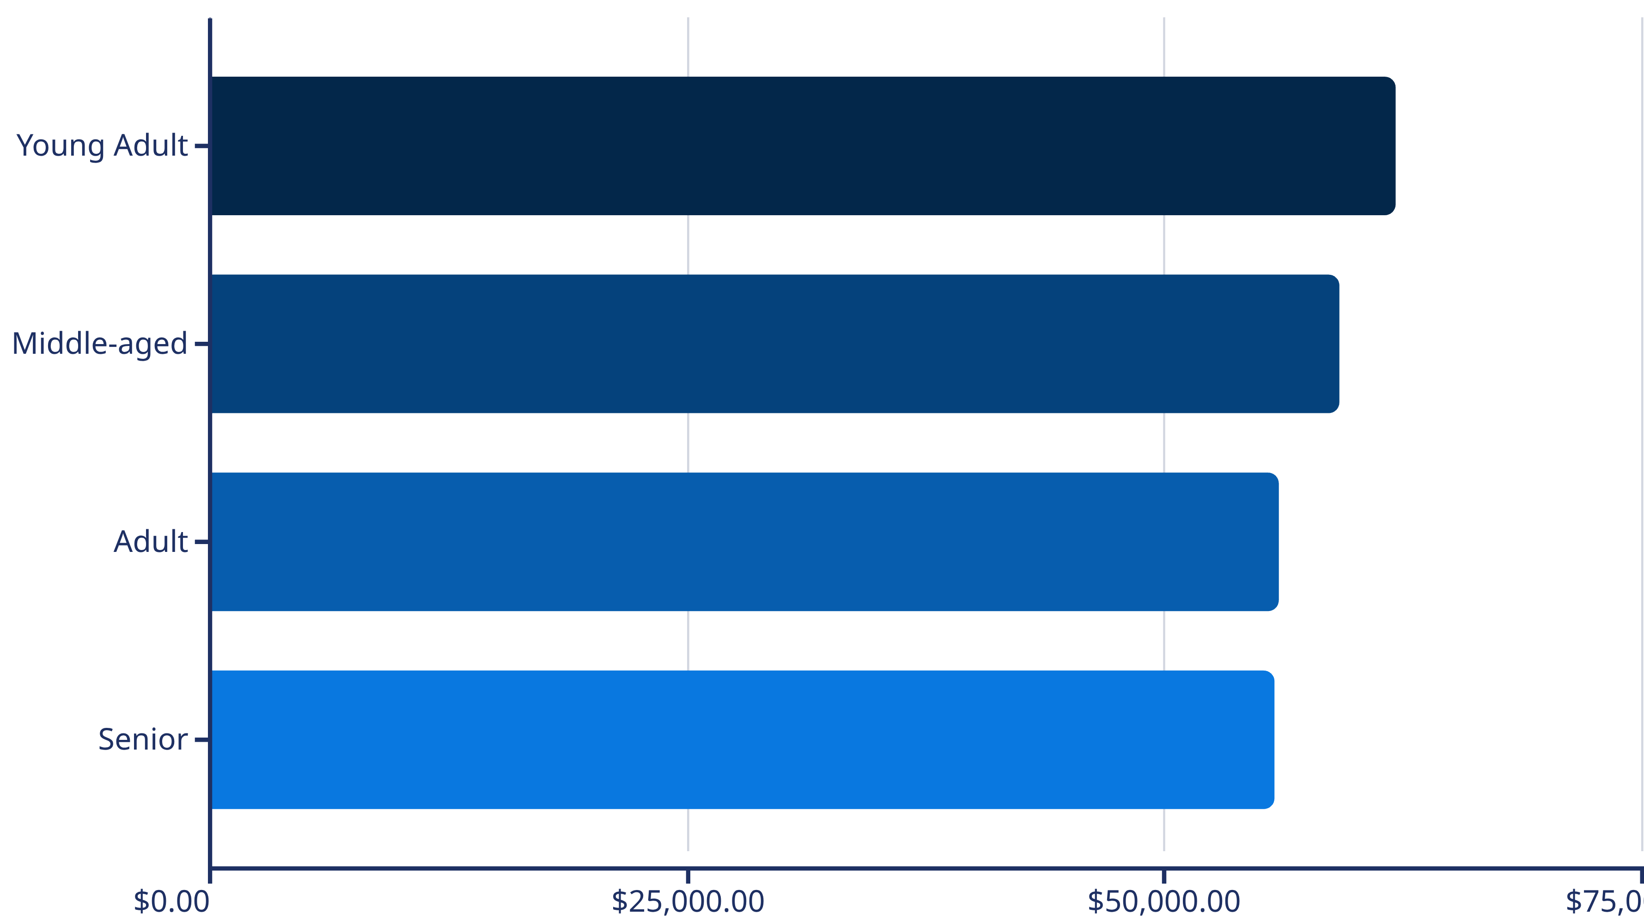
Revenue Distribution
Young adults lead revenue generation, followed closely by middle-aged customers. All segments show balanced contribution, suggesting broad market appeal.

Slide 10

STRATEGY
Business Recommendations
Boost Subscriptions
Loyalty Programs
Review Discounts
Product Positioning
Promote exclusive benefits to convert the 73% non-subscribers
Reward repeat buyers to move 701 returning customers into loyal segment
Balance sales boosts with margin control for sustainable growth
Highlight top-rated items like Gloves and Sandals in campaigns
Targeted Marketing
Focus on high-revenue age groups and express-shipping users

